Slide 1
Regional Health Partnership 16
Telepsychiatry in the Emergency Room

Slide 2
Regional Telepsychiatry Project
RHP 16 had mutual desire to include all providers in regional projects
Private, urban hospitals in RHP 16 were interested in partnerships that would benefit urban and rural providers
Mental health providers and access to care for mental health is lacking in RHP 16
Providence Healthcare Network recognized the need for mental health and presented a project that would benefit all providers in RHP 16
IGT is supported by 3 public entities (all rural hospitals) in RHP 16.
Each rural provider has their own Telepsychiatry project in addition to Providence Healthcare Network
Each project is unique to the area being served and Category 3 outcome selections are not always identical

Slide 3
Providence Healthcare Network

Slide 4
Providence Healthcare Network
Nonprofit private hospital located in Waco, TX (Population around 130,000)
Founded in 1905
We are a member of a larger health ministry known as Ascension Health which is the largest Catholic and largest nonprofit health system
Located in McLennan county in RHP 16
Population of McLennan County: 245,000 (as of 2014)

Slide 5
Providence Healthcare Network
237 bed, acute-care hospital
Currently have 18 clinics that service a variety of needs.
We also have the Providence DePaul Center (Mental Health), Providence Park (Senior Services), Providence Home Care, and a Providence Medical Equipment Center that provide as well.

Slide 6
RHP 16
Counties:
McLennan
Coryell
Falls
Hamilton
Hill
Limestone
Bosque

Slide 7
TelePsychiatry Project
Created through the community needs assessment.
Along with other hospitals in RHP 16, we provide TelePsychiatry services to those who present a behavioral or mental health need.
These services are contracted through an external vendor.
As part of the project, we provide the equipment and assistance to get facilities up and running. (i.e. training, site visits, learning collaborates, etc.).
Currently doing consults in 7 different locations.
We are working toward expansion into other specialties. (i.e. Neurology & Pediatrics).

Slide 8
Goals for the Project
Our goals were to have 1,000 encounters in DY3, 1050 in DY4, and around 1500 in DY5
The category 3 measure for Providence Health System is the ED throughput bundle where we measure how quickly patients are leaving our ED.

Slide 9
Encounters

Slide 10
Challenges
Category 3 Reporting
Patient Disposition – Transportation
Technology
Physician Credentialing
Inpatient Bed Availability
Communication
Physician Buy-in
Staff Buy-in
Meeting the needs of a diverse group of providers.

Slide 11
Lessons Learned
Physician and staff buy-in was needed to ensure positive change.
Telepsych services can be provided in locations other than emergency departments.
Behavioral health needs were greater than anticipated.
Favorable results in DY3, DY4, and into DY5.

Slide 12
Moving Forward
Expansion of the project into other specialties.
Improving transportation between facilities.
Looking at the spectrum of mental health.

Slide 13
Coryell Memorial Healthcare System

Slide 14
Coryell Memorial Healthcare System
Local non-profit governmental entity, Coryell County Memorial Hospital Authority (dba CMHS)
Located in Gatesville, Texas, population 15,872
Centrally located in Coryell County, Texas
Population of Coryell County: 75,388 (as of 2010)
Considered a health professional shortage area (HPSA)
Political subdivision in Texas within Coryell County
NO TAXING ABILITY
Nine Board members as established by bonded debt instruments

Slide 15
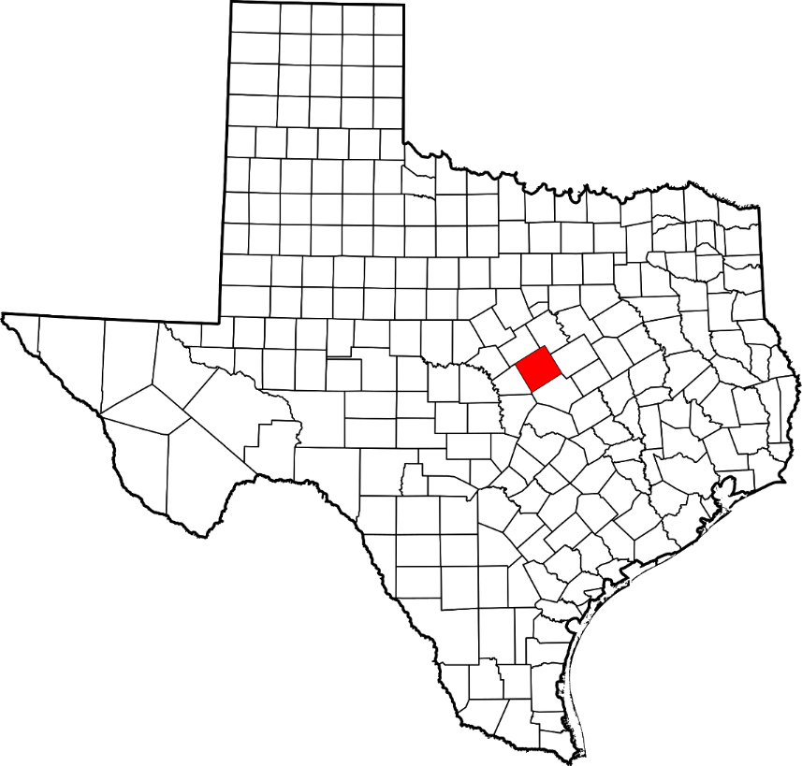
Where is Coryell County?
125 Miles from Dallas/Ft Worth
211 Miles from Houston
96 Miles from Austin

Slide 16
Coryell Memorial Healthcare System
Ethnicity: 61.4% Anglo, 16.6% Hispanic, 16.8% Black, 5.2% Other
25% uninsured residents of Coryell County
5,400 enrolled in elderly or disabled Medicare
6,000 enrolled in Medicaid
56% of residents are between the ages of 15-44.
33.8% living below the poverty level.

Slide 17
Components of the Healthcare System
25-Bed Critical Access Hospital (Acute Care and ICU)
Primary Care Clinic: Family Medicine and Internal Medicine
Specialty Care Clinic:
Local Group Practice: Nephrology, Orthopedic Surgery, General Surgery, Podiatry, Psychology
Independent Contracted Services: General Surgery, Allergy/Asthma, Ophthalmology, Oncology, Pulmonology, Pain Management, Urology
Residential Care on Campus:
90 bed skilled nursing facility (The Meadows)
22 Independent residential apartments (The Oaks)
The Welcome Program, a unique private pay assisted living program

Slide 18
Components of the Healthcare System, continued
Hospitalist Program
Comprehensive Diagnostic Lab and Radiology
Inpatient and Outpatient Rehab Services
Sleep Medicine
Outpatient Dialysis
Advanced Wound Care
Coryell EMS
Level IV Trauma Center (ER physicians are employed by Coryell Memorial Hospital)
Anchor entity for RHP 16 of the 1115 Medicaid Waiver

Slide 19
The Telepsychiatry Project
Project was designed and approved internally by the medical and administrative staff; planning also carried out together with other rural providers
Each participating rural hospital in the region is provided the equipment by Providence Healthcare Network who also negotiates the contract with psychiatry groups and facilitates learning collaboratives throughout the year.
Coryell Memorial is also exploring options to expand the program
Staff in the ER at Coryell Memorial are provided training with regards to policies and procedures related to TelePsychiatry.
One part-time nurse is responsible for coordinating the referrals from the hospital, clinic and residential areas of the healthcare system to provide the service to patients other than those seen in the ER.

Slide 20
Early Accomplishments/ Milestones
Our goal is to achieve more than 250 encounters in the ER, clinic, hospital and nursing home by September 30, 2015, and another 260 by September 30, 2016.
All of these patients would not have received a local psychiatric consult prior to the implementation of the program.
Reduced number of patients in the ER with mental health diagnosis as these patients are being seen in the clinic (Category 3 outcome measure for the 1115 Waiver program)
As a result of the Telepsychiatry program, we were able to justify the addition of a Licensed Psychologist (PhD) who can provide timely follow-up after hospital discharge.
We have seen an improvement in communication between local law enforcement although opportunities still exist to improve timeliness of care.

Slide 21
Telepsych Encounters

Slide 22
Telepsych - Accomplishments
Average cost of ER visit: $1,500
38 patients were seen in the clinic and not referred to the ER: Cost Savings approximately $57,000 for ER visits. This does not include potential cost savings associated with a transfer (transportation) or extended days in the emergency room (waiting for an available bed).
48 patients were discharged from the ER and not transferred to an inpatient facility: Potential Cost Savings $720,000. This can vary based on age of the patient, insurance coverage and condition of the patient.
Local mental health deputies with Coryell County (another 1115 Waiver project) are assisting with transfers from the clinic which has greatly reduced wait times for patients who need to be transferred to a mental health facility.

Slide 23
Lessons Learned
Some patients may wait several days in the ER before they can be transferred due to lack of available beds for mental health patients in Texas.
Must have dedicated staff for the project in order to maintain accountability and continued growth in the program.
Equipment cost for Telepsychiatry is very cost effective although there is a need to explore recent developments in technology to improve communication tools between patient and provider
Potentially use Telepsychiatry as a tool to create an integrated primary care clinic with mental health.
Telepsychiatry has opened the door for a discussion about expansion to other specialties.
Credentialing telemedicine providers can be a time consuming and costly process if the group practice is not accredited, especially for rural facilities.
Still need more time to determine the long term success of the program.

Slide 24
Contact Information
Cole Sims – Providence Health System
cole.sims@phn-waco.org; 254-751-4554
Kathy Lee – Coryell Memorial Hospital
k.lee@cmhos.org; 254-248-6364

